Slide 1
Energy Conservation: Empowering eSC for a Greener Future

Slide 2
Project Overview
Goals
The primary objective is to analyze energy usage patterns, identify key drivers, and develop strategies to encourage energy saving among customers. This approach aims to reduce the need for additional energy production facilities, thereby supporting both operational efficiency and environmental conservation.

Slide 3
TABLE OF CONTENTS
Understanding the Data
Summarization Patterns
Data Modeling
1
3
5
2
4
6
Overview of Important Variables
Key Visualization Takeaways
Future Considerations

Slide 4
UNDERSTANDING THE DATA
1

Slide 5
We have 759,900 observations
Passive Healthcare
Child Preventative Health
Optimize Budget
These are from around 5,000 buildings and 31 days
We had 117 rows
Consisting out energy consumption variables and other building variables
Promote health and wellness, vaccines, and smoke free lifestyle at young age
Allocate more money to variables that produce unpredictable costs

Slide 6
OVERVIEW OF IMPORTANT VARIABLES
2

Slide 7
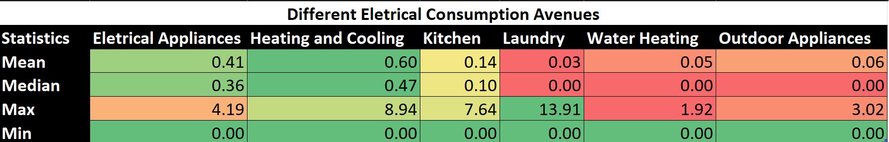

Slide 8
CLASSIFICATIONS
Cost
BMI
AGE
CHILD

Slide 9
COST CLASSIFICATIONS
EXPENSIVE
Expensive individuals are classified as those with healthcare costs in the top 25% of the dataset. This equates to individuals with healthcare costs greater than $4,775.
INEXPENSIVE
Inexpensive individuals are classified as those with healthcare costs in the bottom 75% of the dataset. This equates to individuals with healthcare costs less than $4,775.
$

Slide 10
BODY MASS INDEX (BMI)
OBESE
Less than 18.5
OVERWEIGHT
Between 18.5 and 25.00
HEALTHY
Between 25.00 and 30.00
UNDERWEIGHT
Greater than 30.00

Slide 11
AGE
YOUNG ADULT
Ages 18-34
EARLY MIDDLE-AGED ADULT
Ages 35-44
LATE MIDDLE-AGED ADULT
Ages 45 and Above

Slide 12
CHILDREN
Any Children
1 or more children
No Children
No children

Slide 13
SUMMARIZATION PATTERNS
3

Slide 14
FREQUENCY &
COST
Attributes with low frequencies had high total average healthcare costs

Slide 15
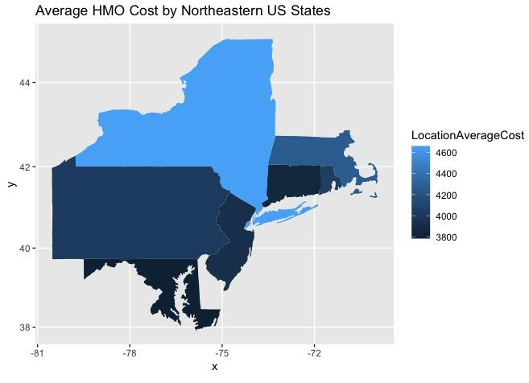
Notes:
This graph also fits the pattern. Most individuals within the dataset are located in Pennsylvania, however, they don’t account for most of the healthcare costs. New York State does.

Slide 16
LOW FREQUENCY, HIGH AVERAGE COST
 | Country | PhD and No College Degree | HBP | Yearly Physical | Single | Smokers
% of Total | 25.0% | 19.4% | 19.8% | 24.8% | 33.3% | 19.5%
% Difference in Average Cost | 0.3% | 3.0% | 11.0% | -0.4% | 2.7% | 301.8%
Notes:
Could it just be skewed data or is it truly that these minority populations may be correlated with higher healthcare costs?

Slide 17
UNPREDICTABILITY
Identifying attributes with varying, inconsistent costs can provide value to HMO
Notes:
To see if these averages were misleading our observations, we created box plots. And from this analysis, we noticed that unpredictability can be valuable for HMOs to understand.

Slide 18
Cost Unpredictability
12,500
10,000
Key
7,500
Mean
5,000
Median
2,500
0
Obese Individuals
Late Middle-Aged Adults
Smokers
Not Active
Children
Notes:
This unpredictability comes from extreme differences in a variable’s mean and median. We focused on responses that produced far more significant average and median costs. These were 5 attributes that fit this pattern. This is important to understand because take smokers for example. A non-smoker had a consistent average and median. There was no extreme variation in costs. This is opposed to smokers where there were several outliers and variations in costs. HMOs may find it helpful to be able to predict which attributes will produce a certain versus those which may be more difficult to predict.
Understanding these variables can help the HMO forecast costs and budget requirements.

Slide 19
KEY VISUALIZATION TAKEAWAYS
4
Notes:
Although these patterns were insightful, we used the cost classification to help narrow down any potential associations between variables and expensive healthcare costs.

Slide 20
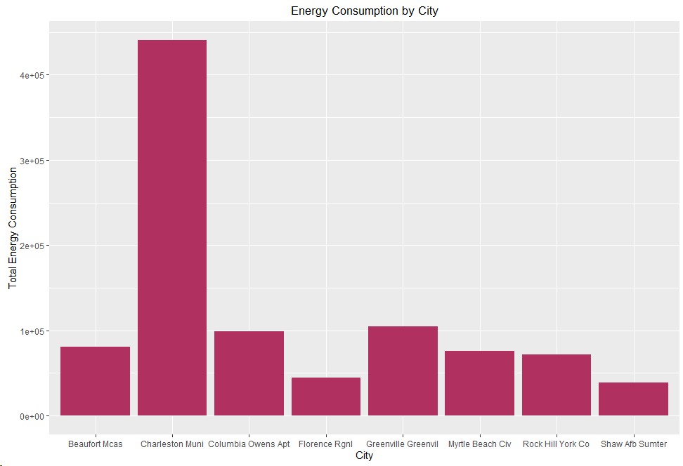
Energy Consumption by City
Charleston has by far the most energy consumed
Florence and Shaw have the least energy consumed
Notes:
There were many more health related variables that appeared to impact who was more likely to be expensive. It’s interesting to note that nearly 30% of Obese and Healthy individuals were expensive. Often we hear that weight can directly impact health. However, it could be that BMI heightens or reduces health issues when coupled with other factors like age and gender or health factors.
These insights were the most significant takeaways - however, visualizations do not paint the entire picture and this leads us into our modeling.

Slide 21
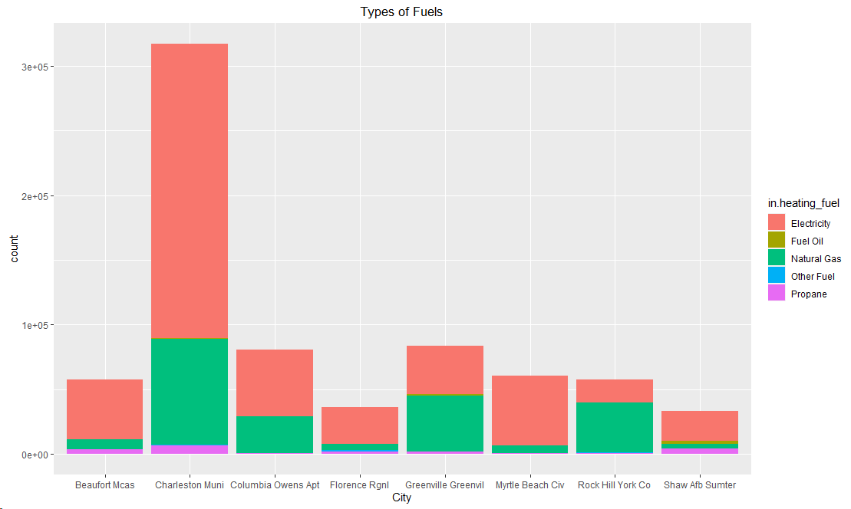
Fuels Used in Each City
Electricity a natural gas by far most common fuels
All other fuels make up small portion of fuels used
Notes:
There were many more health related variables that appeared to impact who was more likely to be expensive. It’s interesting to note that nearly 30% of Obese and Healthy individuals were expensive. Often we hear that weight can directly impact health. However, it could be that BMI heightens or reduces health issues when coupled with other factors like age and gender or health factors.
These insights were the most significant takeaways - however, visualizations do not paint the entire picture and this leads us into our modeling.

Slide 22
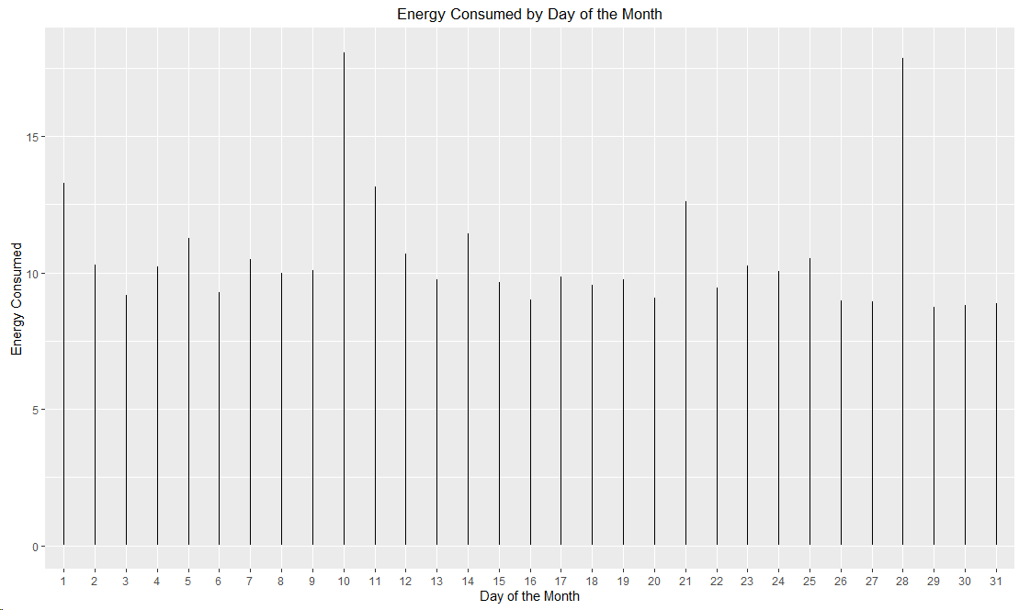
Energy Consumed by Day of the Month
Large peaks around the 10th and 28th
End of the month tends to be less than the beginning

Slide 23
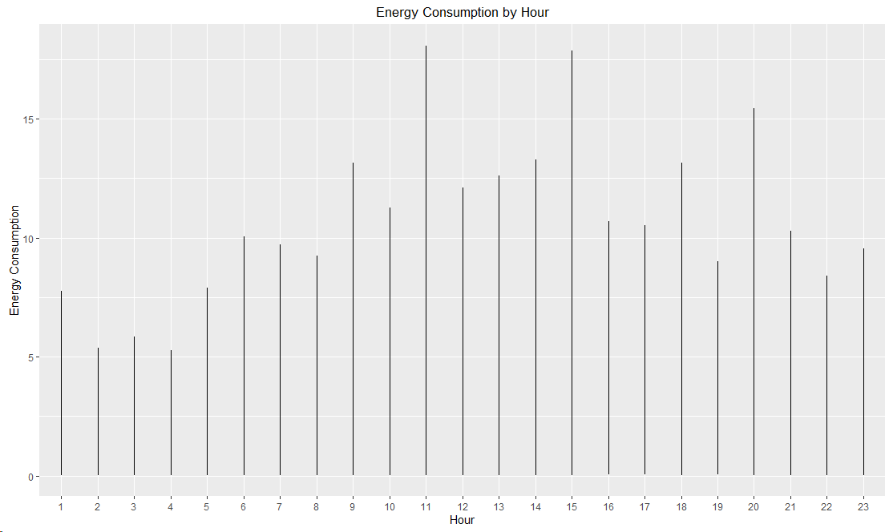
Energy Consumption by Hour
Peaks during hours 11 and 15
See the rise and fall during rush hours

Slide 24
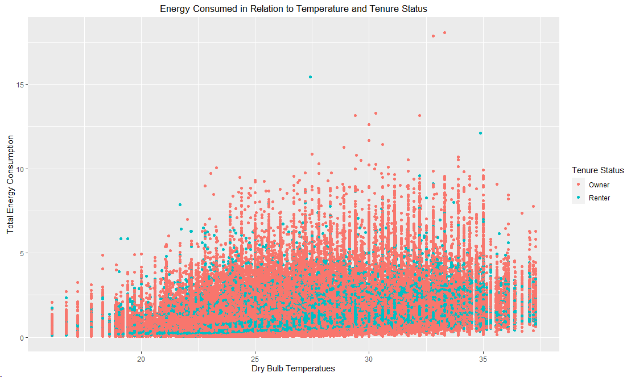
Energy Consumed in Relation to Temperature and Tenure Status
Only small increase in consumption as temperature increases
Owners tend to use more energy than renters

Slide 25
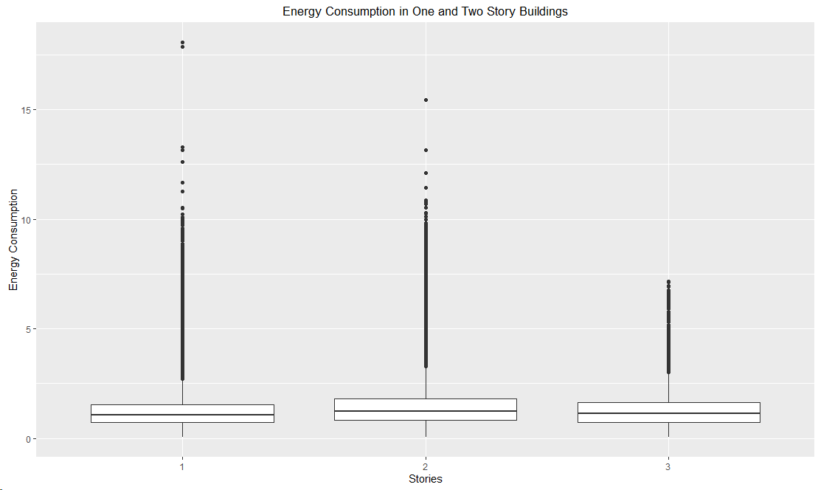
Energy Consumption in One and Two Story Buildings
Consumption does not shift much for different story buildings
All have many outliers

Slide 26
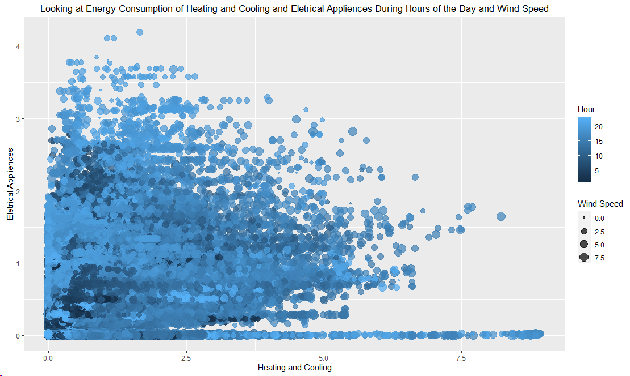
Energy Consumption of Heating and Cooling and Electrical Appliances During Hours of the Day and Wind Speed
Able to see heating cooling consumes more than electrical appliances
When its late in the day and there is little wind, the most energy is consumed

Slide 27
DATA MODELING
5
Notes:
Sania

Slide 28
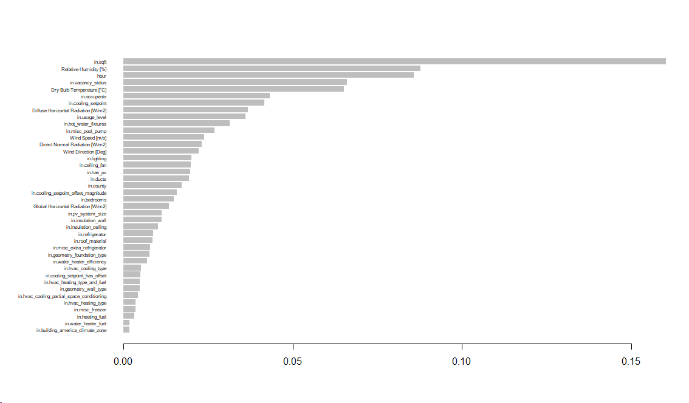
Importance Matrix

Slide 29
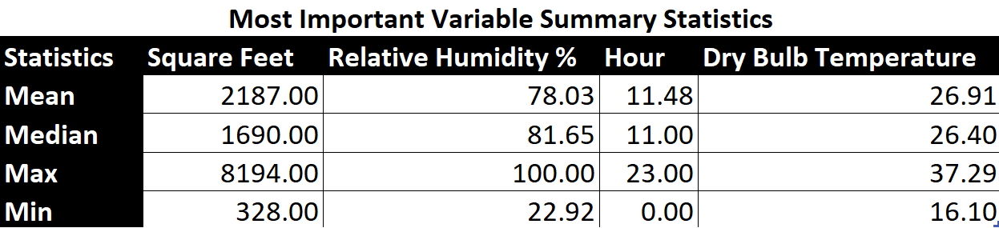

Slide 30
LINEAR REGRESSION
 | Age | BMI | Smoker | Exercise | Children | New York
Impact on Cost | +$65 | +$121 | $480 | -$145 | +$177 | $440>
Notes:
A linear regression was created to determine which variables were most significant
We didn’t predict its accuracy because we our final prediction model is based on expensiveness, not cost
But it’s really helpful in allowing us to get a sense of which variables impact cost the most
Here’s the breakdown of the significant variables and their impact on cost

Slide 31
DECISION TREE
Smoker
BMI
Age
Exercise
Children
89%
0.65
Notes:
We then created a decision tree to first see what variables it classified as the most important
We also then tested its accuracy
We found it classified 5 of the 6 variables from the linear regression as important - it dropped New York
The accuracy was high at 89% and sensitivity at 0.65

Slide 32
SVM WITH 5 SIGNIFICANT VARIABLES
87%
0.57
Accuracy
Sensitivity
Notes:
We then created support vector machines
The first one we created used those 5 variables from the decision tree
We got 87%
0.57 sensitivity

Slide 33
SVM WITH ALL VARIABLES
92%
0.71
Accuracy
Sensitivity
Notes:
However, when we included all variables, we got 92% accuracy and a higher sensitivity
This is the model we ultimately ended up using

Slide 34
Future Considerations
6
Notes:
Jack

Slide 35
Questions?
Thank you!

Slide 36
APPENDIX

Slide 37
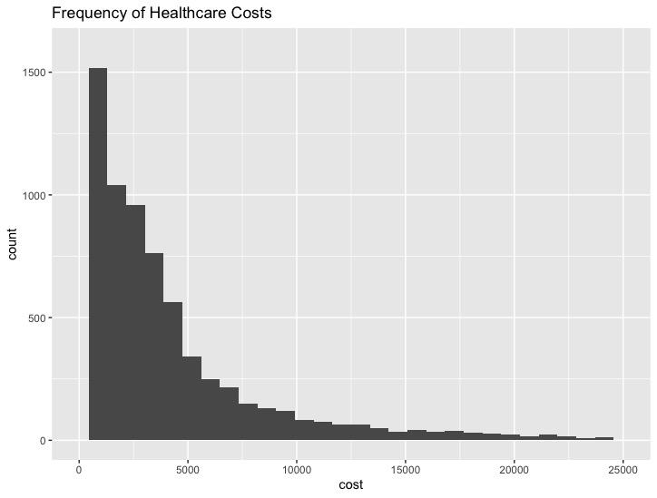
ELIMINATE COSTS OVER ~$5,000
Notes:
40%

Slide 38
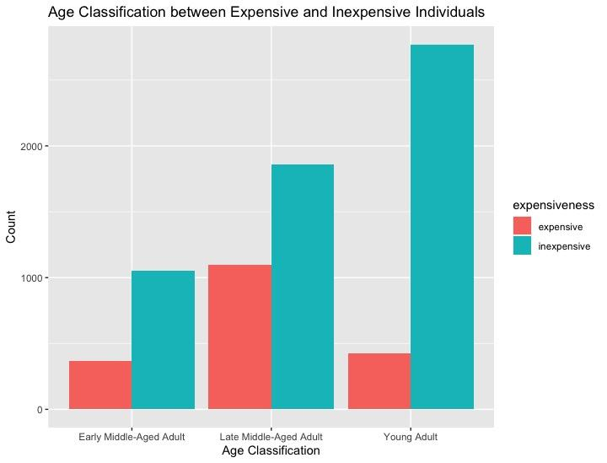
LATE MIDDLE-AGED ADULTS ARE MORE EXPENSIVE
Notes:
40%

Slide 39
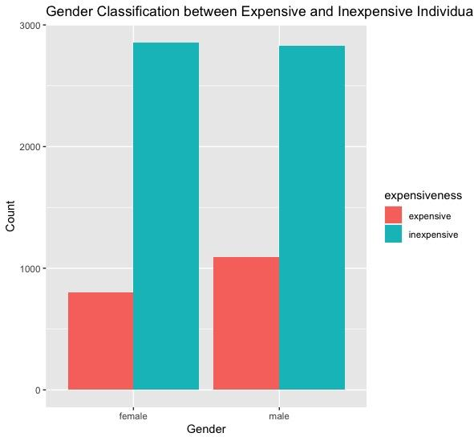
MALES ARE MORE EXPENSIVE
Notes:
Nearly 30%

Slide 40
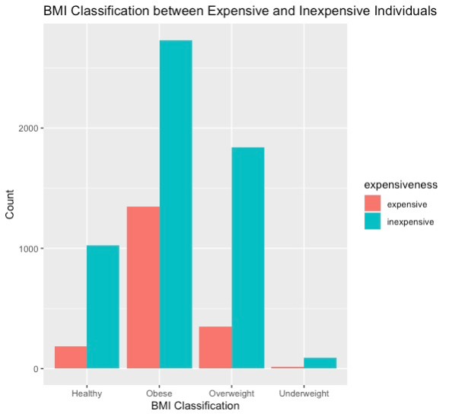
OBESE AND HEALTHY INDIVIDUALS ARE MORE EXPENSIVE
Notes:
33%

Slide 41
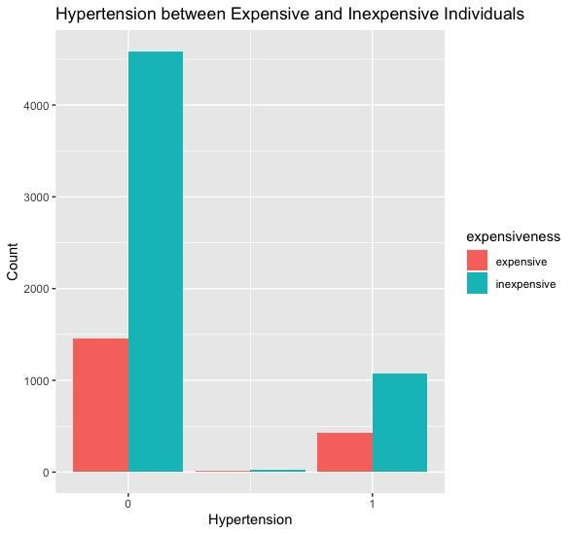
HYPERTENSION MAY LEAD TO HIGHER COSTS
Notes:
Nearly 30%

Slide 42
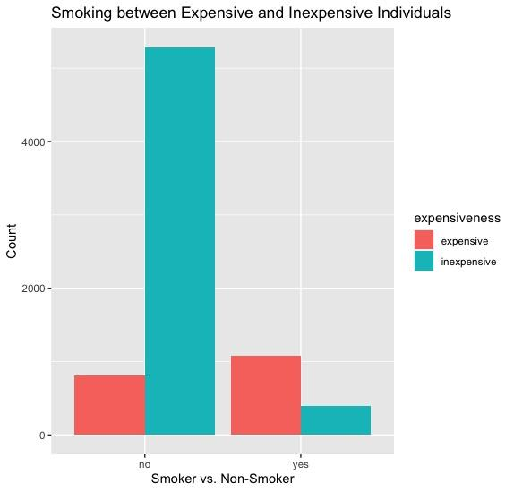
SMOKERS ARE SIGNIFICANTLY MORE EXPENSIVE
Notes:
Nearly 30%

Slide 43
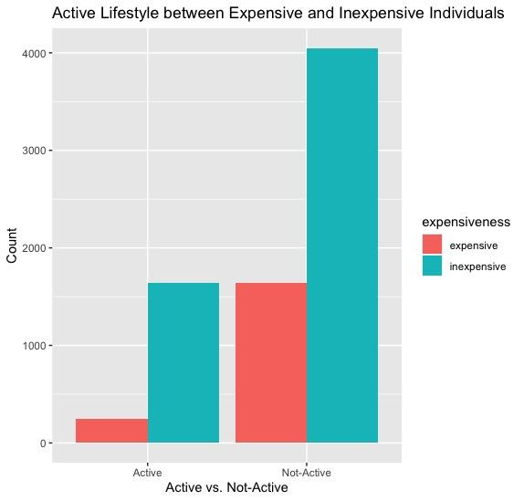
EXERCISE MAY LEAD TO LOWER COSTS
Notes:
Nearly 30%

Slide 44
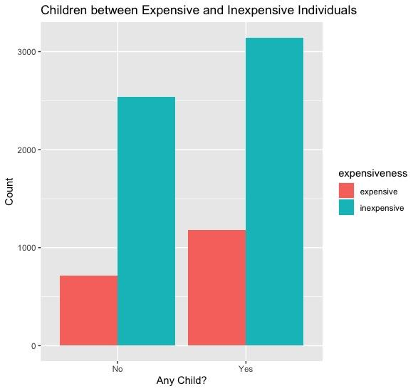
EXERCISE MAY LEAD TO LOWER COSTS
Notes:
Nearly 30%

